Slide 1
Geotechnical data standardization
Viewpoint from Geotechnical FEM package

Slide 2
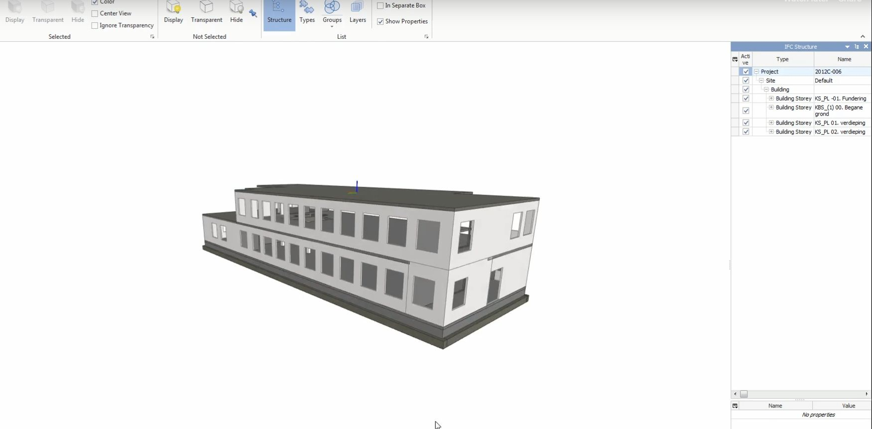
Building Information Model
Combines most aspects of project development above ground
Structural analysis packages oversimplify interaction with soil
Common missing component - > Subsurface

Slide 3
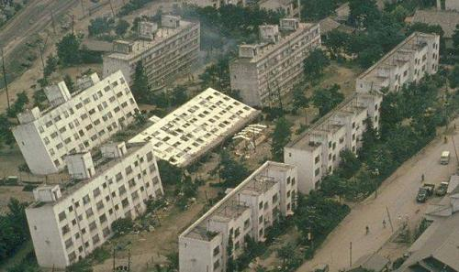
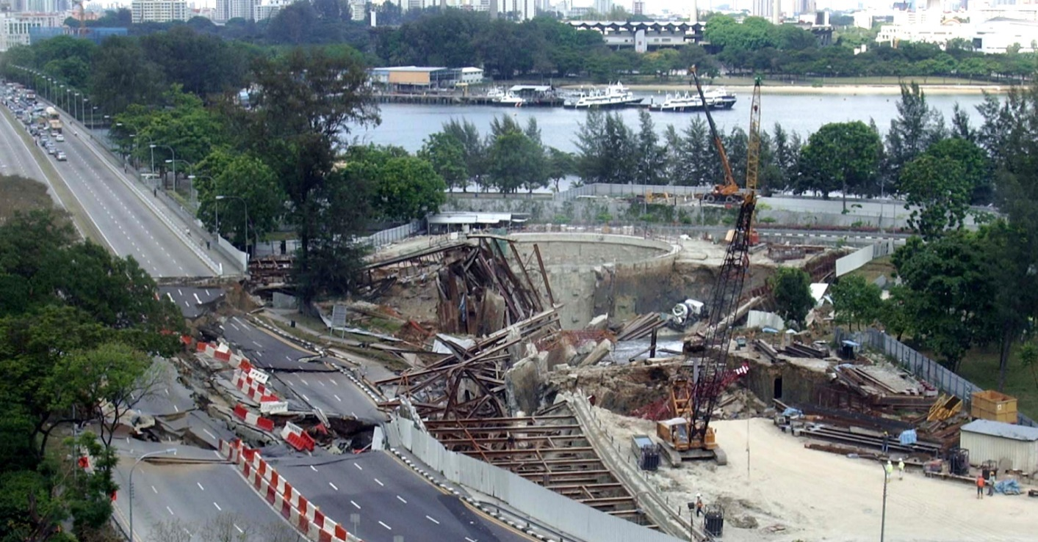
Risks associated with disregarding soil

Slide 4
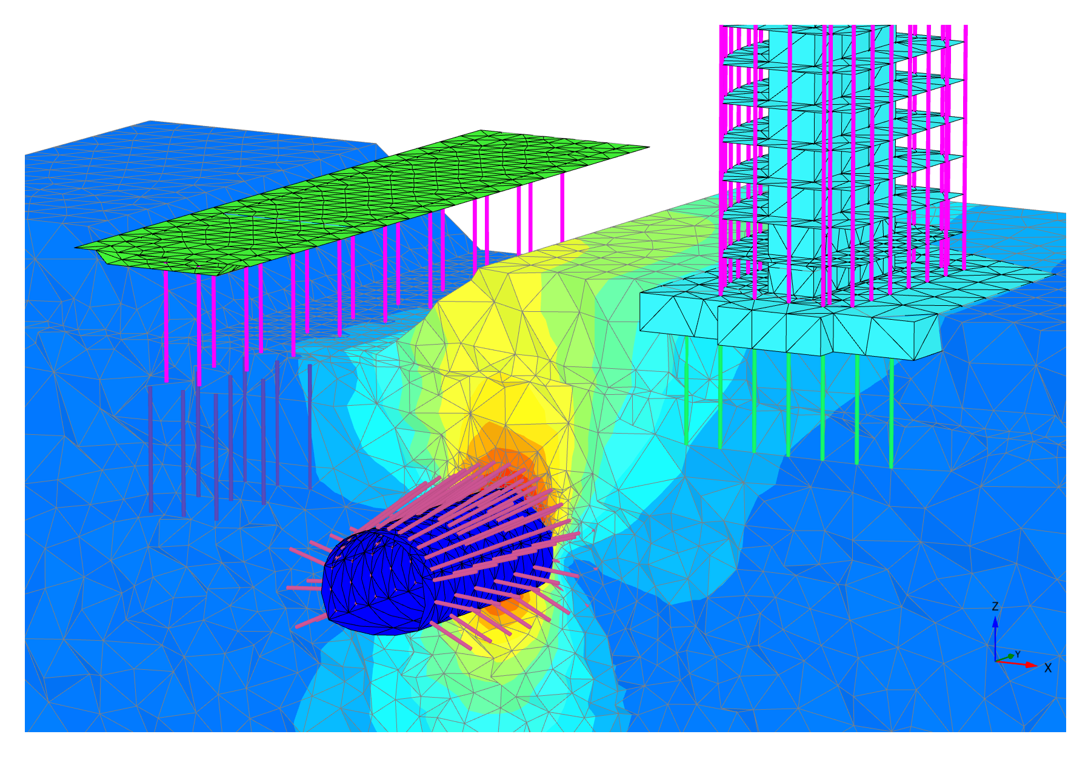
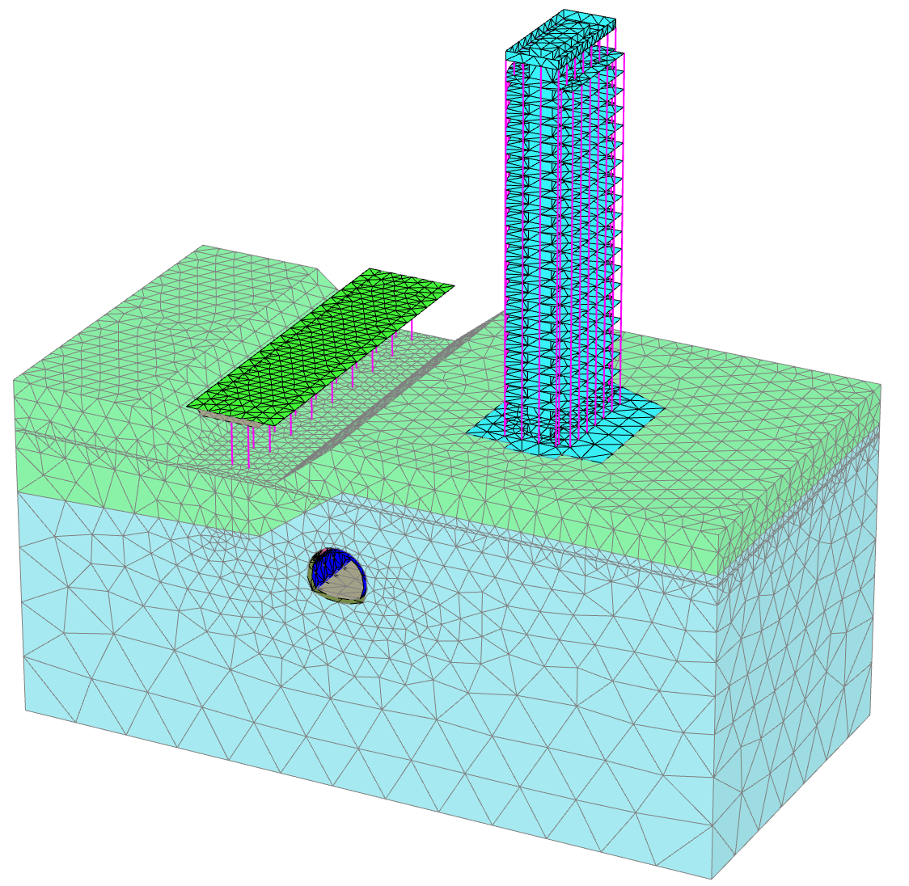
Geotechnical finite element analysis
PLAXIS 2D, 3D, MoDeTo
Soilvision, SVFlux, SVSlope etc.
Soil-structure interaction
Advanced models for behavior of soil and rock

Slide 5
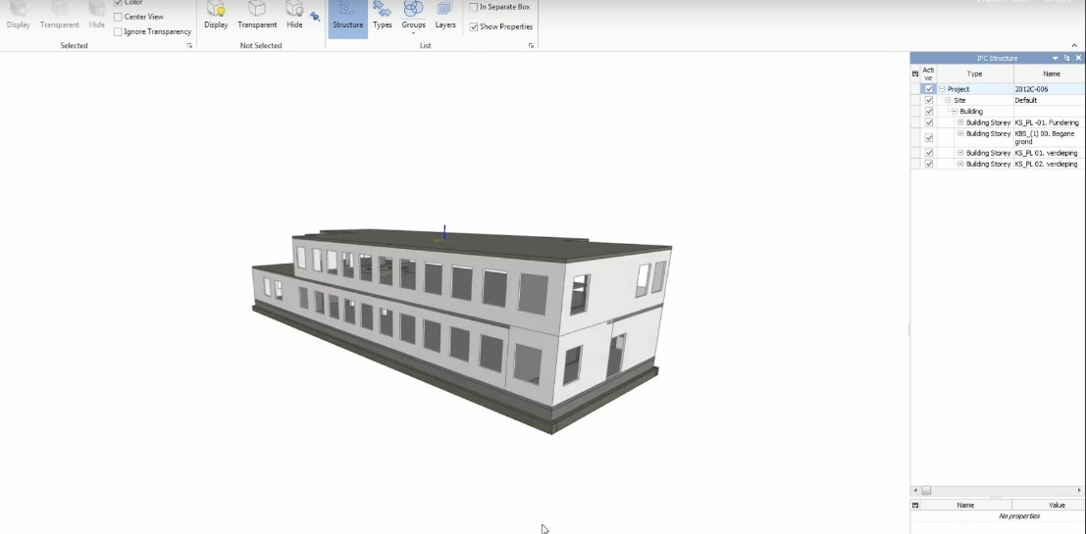
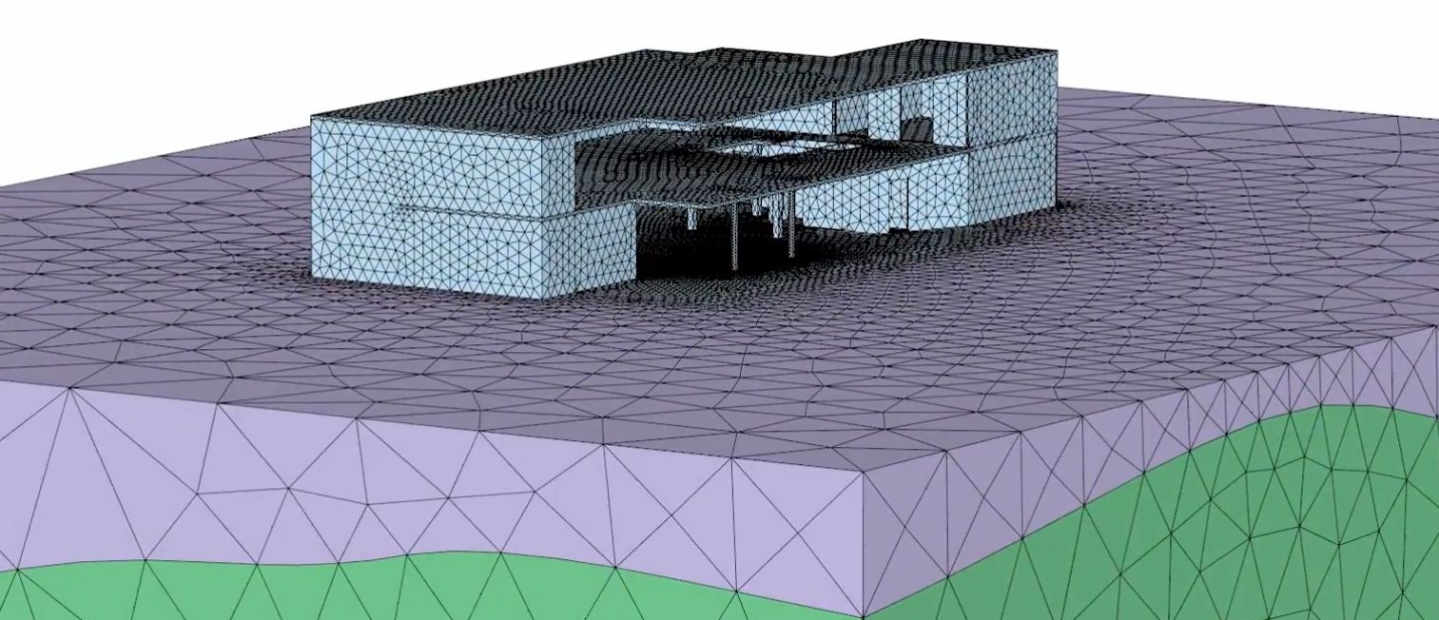
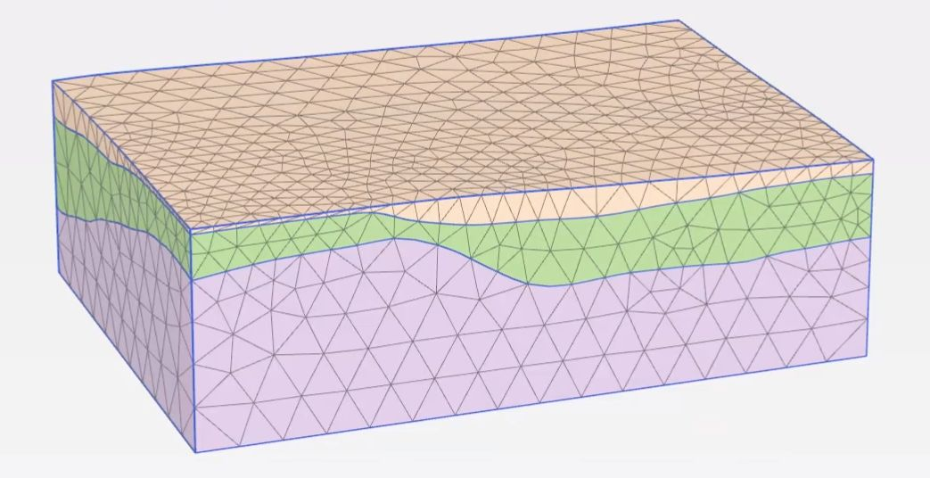
Making a Geotechnical FE model
Create block of soil
Import (or create) structure
Define additional loads
Simulate construction process
Calculate
Assess (development of) forces, settlements etc.

Slide 6
A Simple block of soil?
Uncertainty / spatial variability
Continuity of soil layers
Soil properties
Reworked samples
Engineering judgement
More subsurface data can reduce the uncertainty and associated risk
Storing geotechnical data in a centralized, structured and accessible manner could help

Slide 7

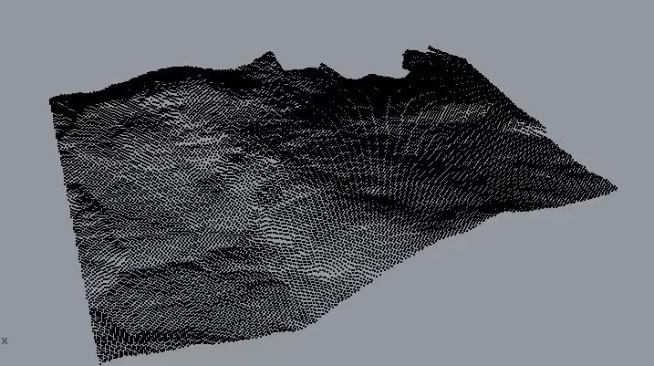
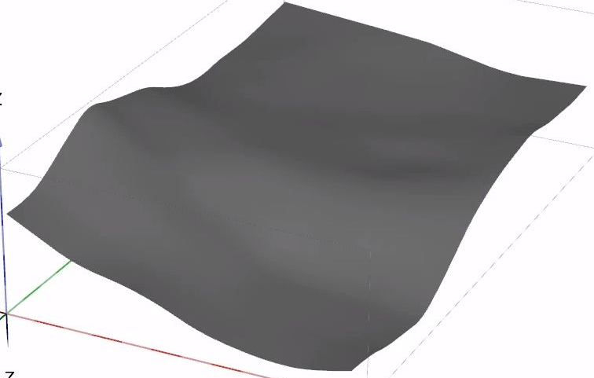
Subsurface model – Survey data
Constitutive models
Survey data
Creation of surface in CAD package
Import into software
Lab tests
Bore logs

Slide 8
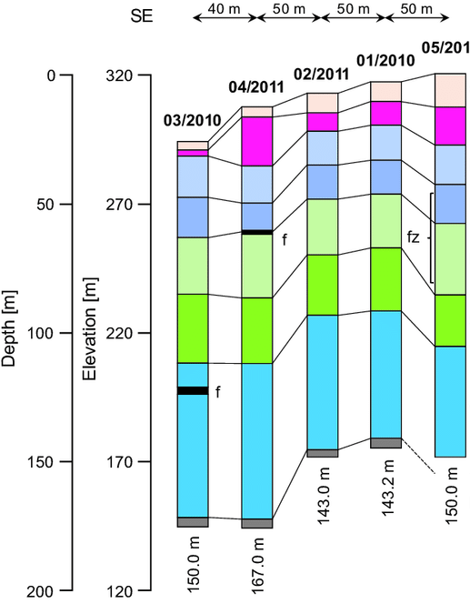
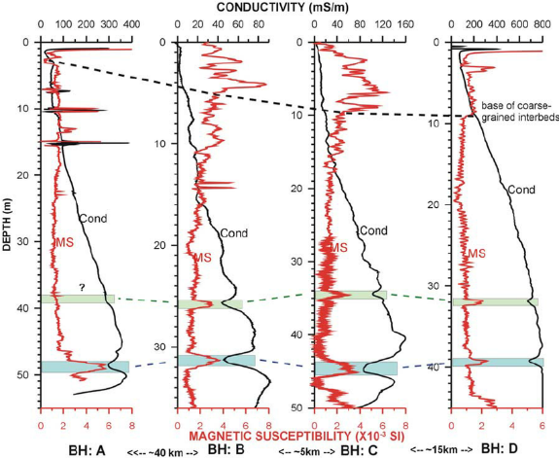
Subsurface model – Bore logs
Constitutive models
Survey data
Determine soil properties
Layers and layer thickness
Create boreholes in software
Lab tests
Bore logs

Slide 9
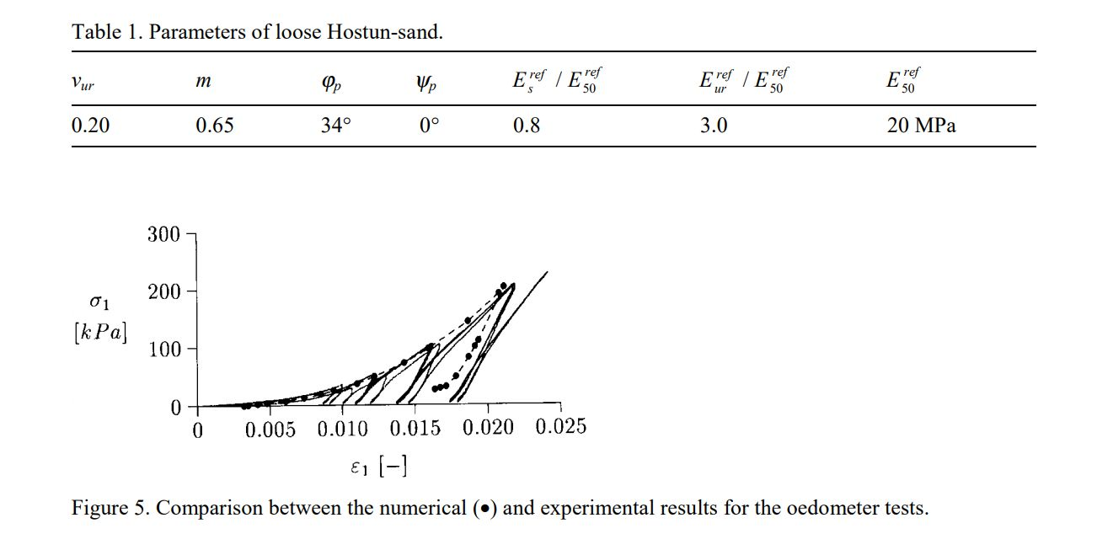
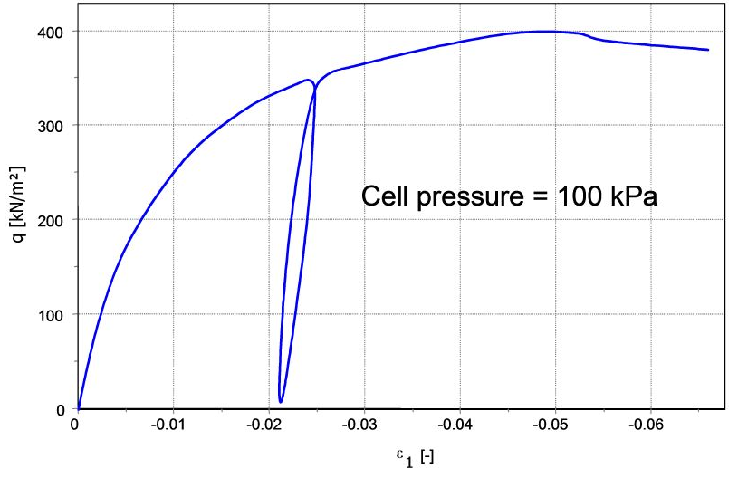
Subsurface model – Lab tests
Survey data
Used to derive soil & model parameters
Stiffness Moduli, Creep
Correlations
Lab tests
Bore logs

Slide 10
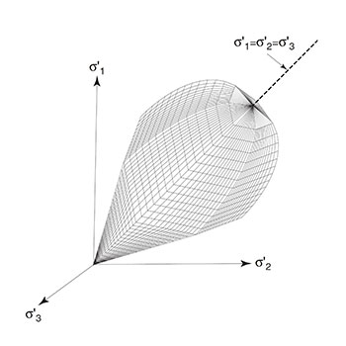
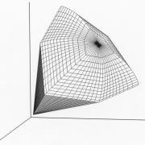
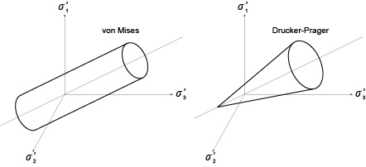
Subsurface model – Constitutive models
Constitutive models
Survey data
Describes behavior of (specific) soils
Unloading / reloading
Hardening
Creep
Select model and input in software
Lab tests
Bore logs

Slide 11
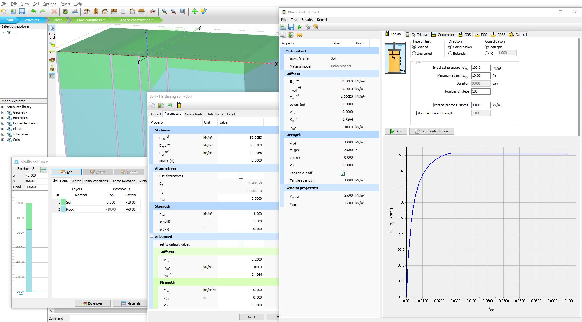
Overview of data input PLAXIS 3D
Notes:
Oveiw

Slide 12

Subsurface information model
Start with factual data:
Survey tools
Logging tools
Lab equipment
Of importance for information model:
Requires interpreted data
Varying interpretations with same factual data
Insight into assumptions
Use additional labtests, bore logs during project
Building Information Model

Slide 13
Subsurface information model
Digital availability of geotechnical data stored in a centralized, structured and accessible manner, to retain, maintain and update data during project lifecycle
Understanding soil to reduce
risk during and after construction
Adopting to a standard?
Should users tell us what they want?
New tools assisting in reducing uncertainty & risk?
Model parameter estimation
Inverse analysis tools
Interpreted (3D) geological/soil model
Interpreted geological / soil model
Earthquake data
Site monitoring tools

